Slide 1

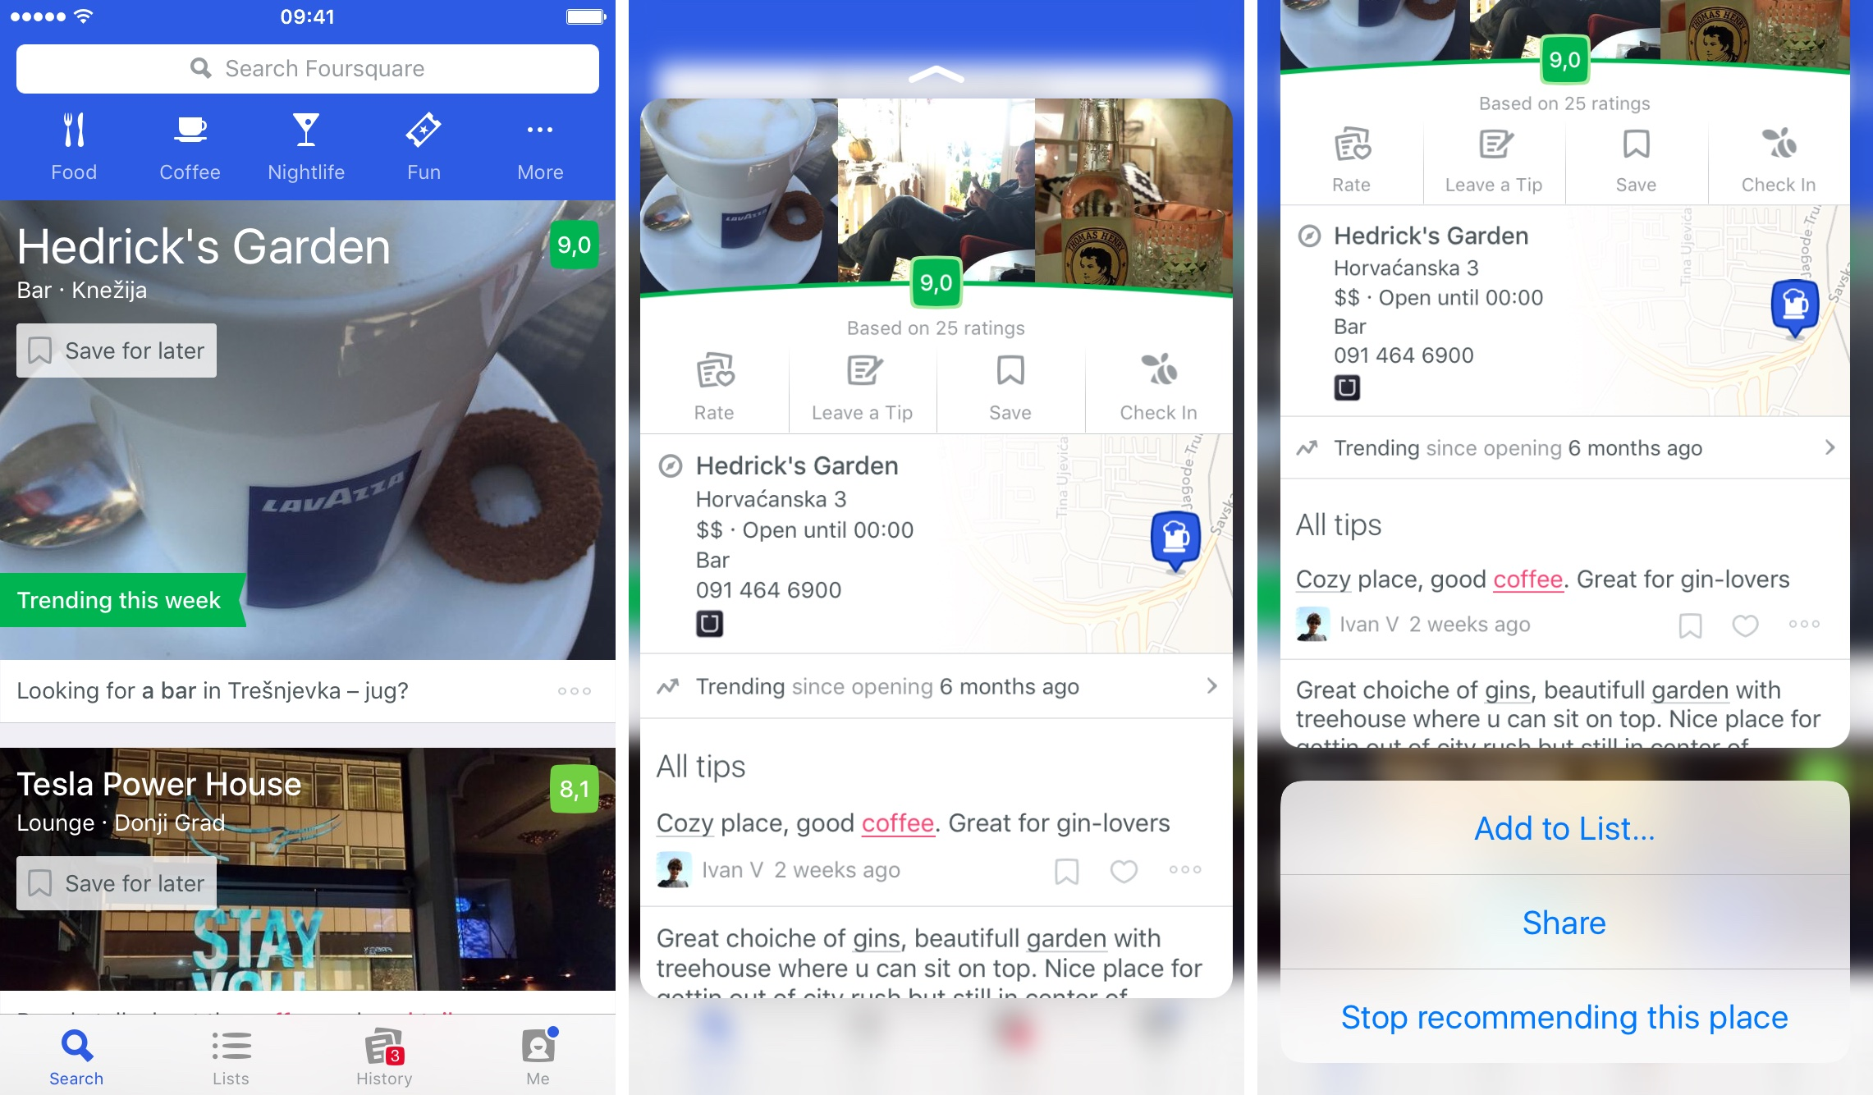
Ideal Locations for New Restaurants in Brandon, FL
Ideal Locations for New Restaurants in Brandon, FL
Predicting Foursquare “Likes” ratio based on local demographics

Slide 2
Introduction
Tampa, FL – most residents live in suburbs, difficult for restaurants to pick locations due to sprawling population with inconsistent demographics
Foursquare’s user-driven evaluations help attract even more customers to restaurants
Predicting locations where a new restaurant is likely to earn positive feedback can help sustain business
Model based on local demographics may explain enough variation to produce useful insights

Slide 3
Data Sources
Foursquare Venues
  Locations
  Category
  Likes
  Signals
  Rating
US Census Bureau
  Census tracts’ estimated counts of subpopulations
  Shapefiles that outline tracts using coordinates

Slide 4
Methodology
Get coordinates for center of suburb (Brandon, FL)
Use Foursquare API to get venue JSONs w/in given radius
Import shapefiles for census tracts, filter to local area
Import census tract demographic CSVs into dataframes
Cluster census tracts based on subpop. proportions
Cross-join venue data to tract data, aggregate per venue
Prep for analysis – main dataframe and subsets

Slide 5
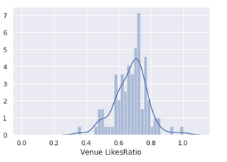
Methodology (cont.)
Review possible dependent variables
  “likes” too biased toward older venues
  “rating” heavily engineered by Foursquare
  “likes ratio” most viable

Slide 6
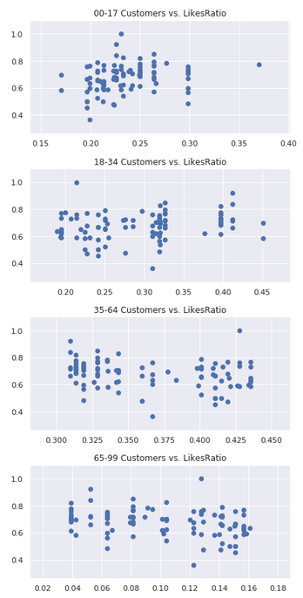
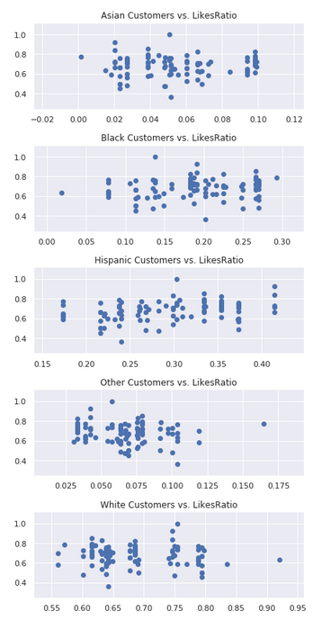
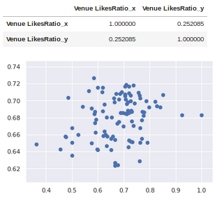
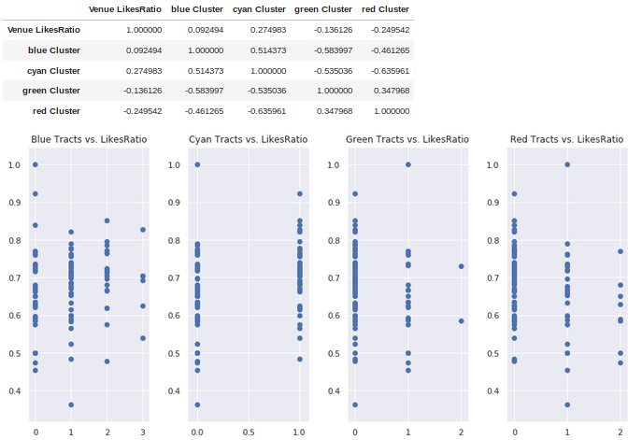
Methodology (cont.)
Select features: start simple, look for obvious patterns, keep options open
    aggregated subpopulations
    venue “competition”
  nearby tracts per cluster
  venue “cuisine”
    worst-case: all dis-aggregated subpopulations
Try multiple machine learning algorithms with each feature set
Use best model to identify “ideal markets”

Slide 7
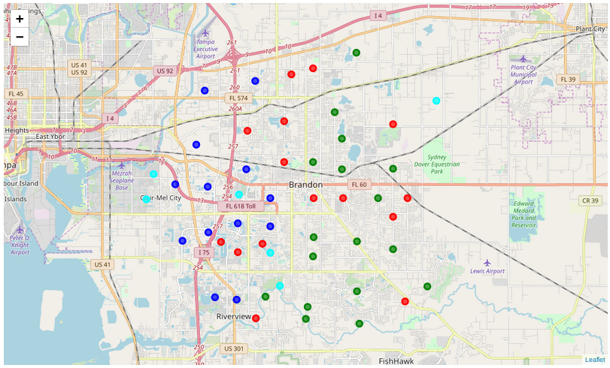
Results: Clustered Tracts
Blue: I-75 corridor, commercial and apartments; many black and young-adult residents
Green: further away from Tampa, many single-family homes; many white residents, few young-adults
Red: along SR60, original Brandon with mix of single-family homes and business; no demographic trends
Cyan: near Tampa except one to the east near farmland; many Hispanic residents, no age trend

Slide 8
Results: Best Model
The best: support vector machine
  0.628 +/- 0.079 (roughly 5 / 8 correct)
The good: logistic regression
  0.618 +/- 0.088 (still consistently better than chance, >50%)
The bad: decision tree
  0.566 +/- 0.083 (<50% was within margin of error)
The ugly: Multi-linear regression
  Couldn’t get any combination of feature sets to reliably produce a positive variance score; using the full set of subpopulations resulted in a massively negative score

Slide 9
Results: Predictions
Cuisine | svmRatio | blue Cluster | cyan Cluster | green Cluster | red Cluster
Cat:American | Bad | 1.18 | 0.41 | 1.11 | 1.11
 | Good | 2.63 | 0.81 | 0.63 | 0.63
Cat:Asian | Bad | 1.48 | 0.49 | 1.01 | 1.01
 | Good | 3.00 | 1.00 | 0.00 | 0.00
Cat:European | Bad | 1.18 | 0.41 | 1.09 | 1.13
 | Good | 2.63 | 0.81 | 0.69 | 0.56
Cat:Fast | Bad | 1.19 | 0.39 | 1.11 | 1.15
 | Good | 2.44 | 0.83 | 0.67 | 0.56
Cat:Joints | Bad | 0.77 | 0.15 | 1.23 | 1.31
 | Good | 1.91 | 0.70 | 0.87 | 0.83
Cat:Latin | Bad | 0.82 | 0.29 | 1.26 | 1.26
 | Good | 2.11 | 0.68 | 0.76 | 0.76
Cat:Other | Bad | 1.34 | 0.45 | 1.05 | 1.09
 | Good | 2.75 | 0.88 | 0.63 | 0.25

Slide 10
General Discussion
Ambitious, ill-fated goals = wasted time; spend more time during planning phase researching potential variables to improve efficiency
Individual features were not strongly-correlated with “likes ratio”; clustering was extremely helpful by reducing the complexity of the issue and allowing for more intuitive analysis
Small-ish sample size due to API rate restrictions probably limited effectiveness of machine-learning algorithms meant to be used on thousands of records

Slide 11
Recommendations
Recommendation for most cuisines: multiple “blue” tracts nearby, minimal “green” or “red” tracts; “cyan” tracts not much of a factor
Asian restaurants are unique: must have “cyan” tracts, “blue” tracts are less important
Both recommendations align with common-sense based on context of local economic geography, i.e. stick to the areas where most other restaurants already are, where the young-adults are rather than families and retirees; any possible racial trend is probably a symptom of the age trend rather than a true predictor, so not much need to worry about matching cuisines’ international sources to customers’ ancestral origins

Slide 12
Conclusion
Telling the hard truth: this model does not provide much counter-intuitive or nuanced insight
Positive framing! Plenty of opportunities for improvement and lessons learned about process
  Start small and simple, expand scope and complexity after building reliable foundation (current model)
  Introduce additional data to turn implicit contextual knowledge into explicit features:
    economic data about residents
    price ranges for restaurants
    additional businesses not on Foursquare or non-restaurant businesses
    Separating effects of race and age distributions (different cluster sets?

